Slide 1
Plant layout

Slide 2
Plant Layout
Meaning
Arrangement of-
Machinery
Equipment
Other industrial facilities
- for achieving quick production at least cost

Slide 3
Objectives of Good Layout
-Material Handling cost
-Movement of people and material
-Hazards to personnel
-Accidents
-Production capacity
-Labor Efficiency
- Employee Morale
- Space Utilization
- Ease of supervision and Maintenance

Slide 4
Factors
Material
Product
Manpower
Machinery
Type of Industry
Location
Management Policies

Slide 5
Principles for Ideal Layout
Minimum Travel
Sequence
Usage and Flexibility
Safety and Satisfaction
Compactness and Minimum Investment
Ideal Layout

Slide 6
Importance
Economies in handling
Effective use of available area
Minimization of production delays
Improved quality control
Avoidance of bottlenecks

Slide 7
Importance
Better production control
Better Supervision
Improved utilization of labor
Improved Employee Morale
Avoidance of unnecessary and costly changes

Slide 8
Types of Layout
Product Layout
Fixed Position Layout
Process Layout
Cellular manufacturing Layout
Service Facility Layout
Combined Layout

Slide 9
Product Layout
Straight Line or layout for serialized manufacturing
Arrangement of machines in ONE LINE depending on the sequence of operations
Materials are fed in the first machine and finished product comes out from the last machine
E.g. Sugarcane Mill or Paper Mill
L- Lathe D- Drilling M- Milling G- Grinding I-Inspection D - Dispatch
L
D
M
G
I
D

Slide 10
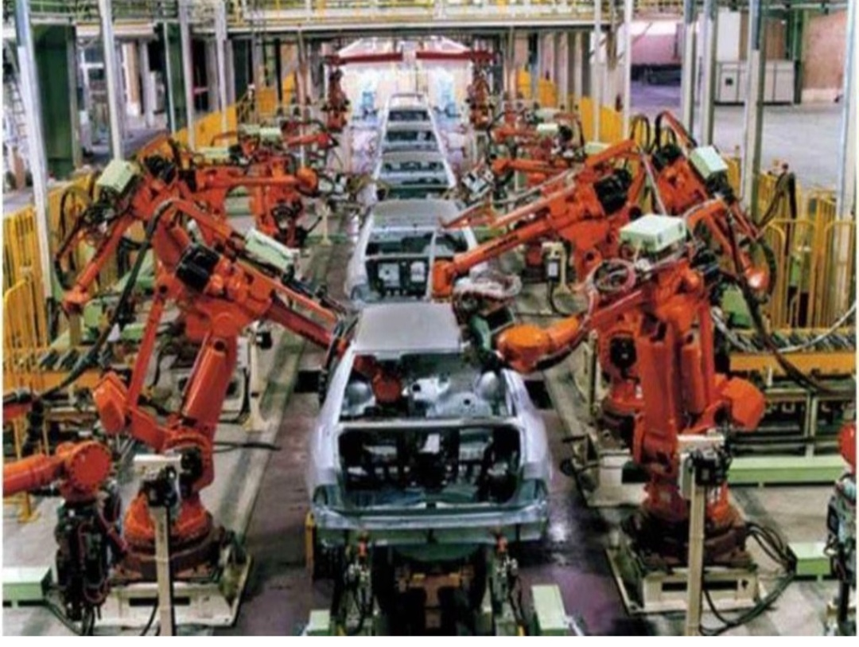

Slide 11
Advantages
Low material handling cost per unit
Less work in progress
Less skill is required for personnel
Continuous flow of work
Shorter processing time or quicker output
Simplified and lesser production control
Disadvantages
High capital investment in special purpose machines
breakdown of one machine will hamper the whole production process
Slow machine affects on overall productivity of organization
Less flexibility as specially out for particular product

Slide 12
Suitability of product layout
Continuous and Mass production of standardized products
Simple and repetitive manufacturing process
Reasonably stable demand for the product
E.g. Chemicals, Sugar, Paper, Rubber, refineries, Automobiles, food processing

Slide 13
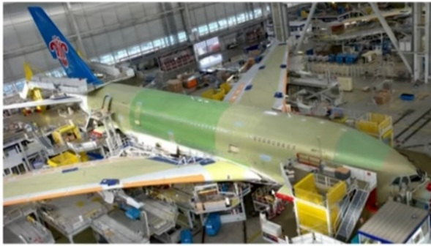
Fixed Position Layout
Movement of men and machines to the product
Bulky product
E. g. Aircraft Assembling, Ships building etc.

Slide 14
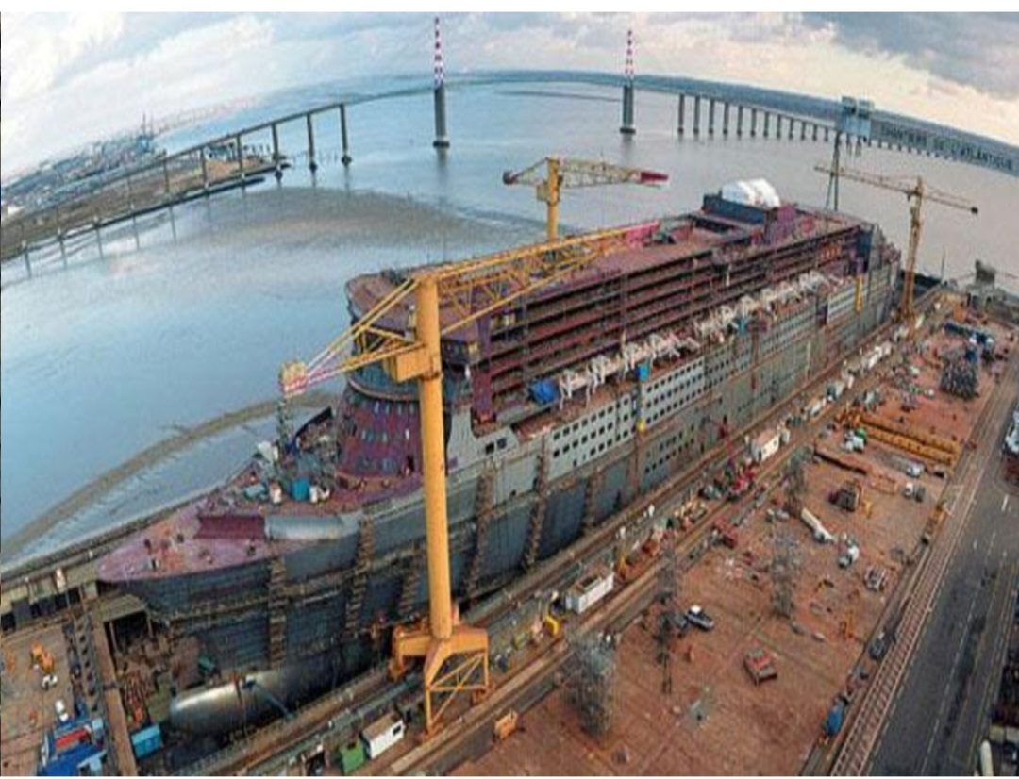

Slide 15
Advantages
Saves cost involved in movement of product
Flexible- Easily adapt changes in job design and operation sequence
Economical- several orders in different stages of progress are being executed simultaneously.
Adjustment- shortage of material and absence of labor can be adjusted by changing sequence of operation
Disadvantage
Long production period, high capital investment
Very large space required
Several operations carried out simultaneously which creates confusion and conflicts among work groups.

Slide 16
Suitability of Fixed Position Layout
Manufacturing of bulky and heavy products such as locomotives, ships, boilers, generators, wagon building, aircraft manufacturing etc.
Construction of building, flyovers, dams

Slide 17
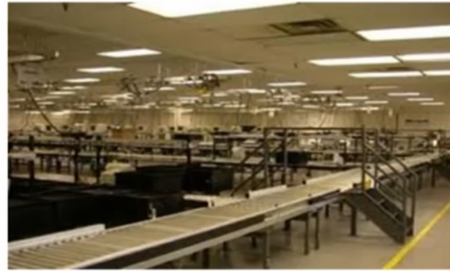
Process Layout
Functional layout/job lot manufacturing or batch production layout
Involves grouping of like machines in one department
General purpose machines

Slide 18
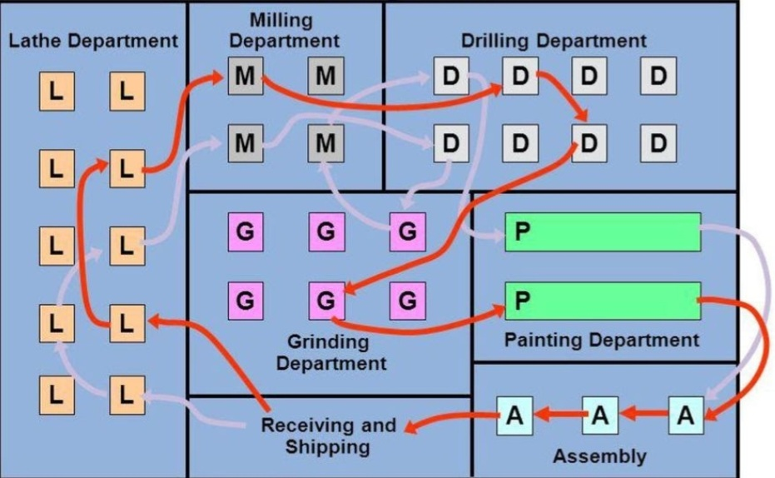

Slide 19
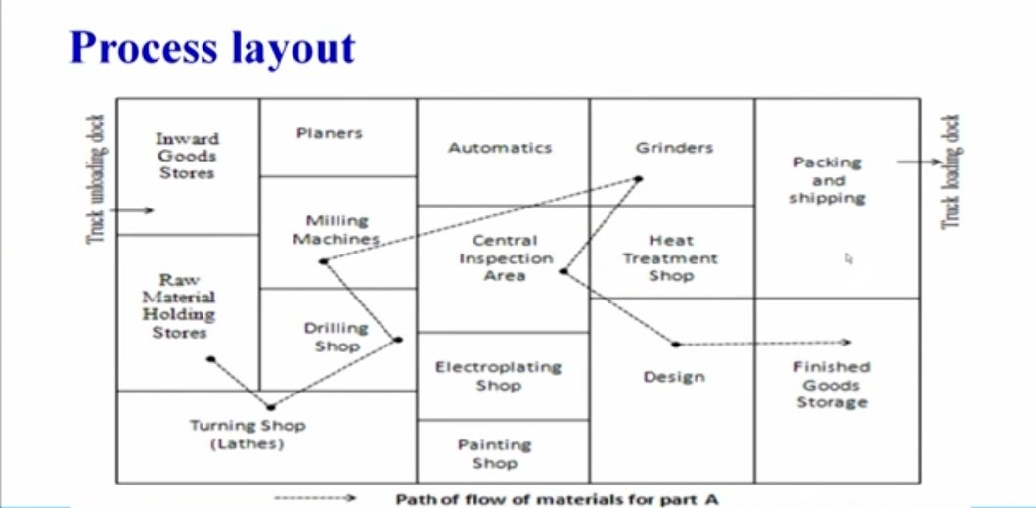

Slide 20
Advantages
Break down of one machine does not affects overall productivity
Slow machine does affect on overall productivity
High utilization of machines as machine is used for various types of product processing
Change in design and volume can be easily adapted to the output of variety of products
More effective supervision
Greater flexibility
Disadvantages
High material handling cost( Backtracking)
More Time lag in production
High WIP inventory
More frequent inspection required

Slide 21
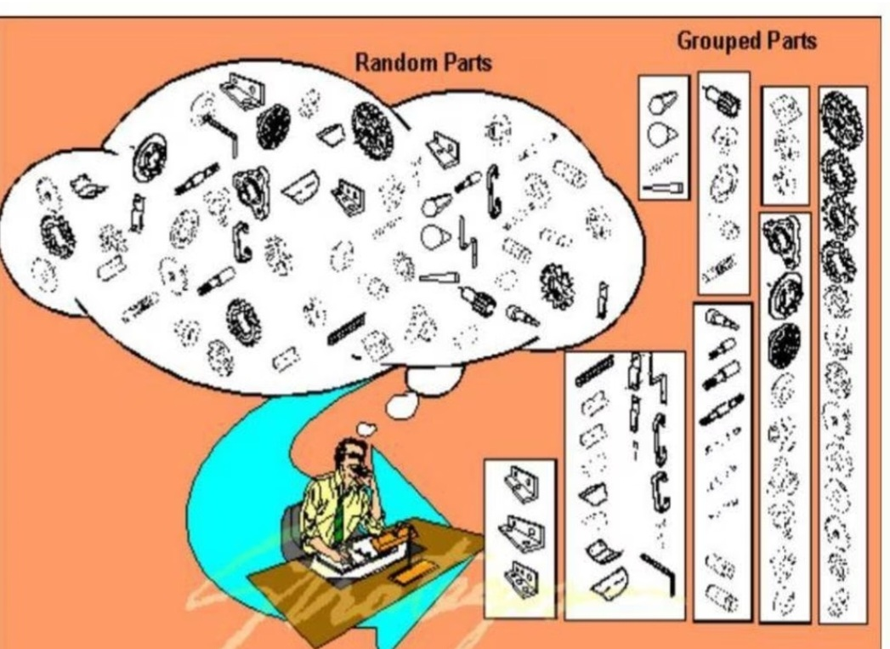
Cellular Manufacturing
Group Technology- A manufacturing Philosophy in which similar parts are identified and grouped together to take advantage of their similarities in design and production.
Machines grouped into cells
Each cell is formed to produce a few parts with common characteristics
Similarities among parts permits them to be classified into part families
Each part family, processing steps are similar
Organizing the production facilities into manufacturing cells that specialize in production of certain part families
Machines are grouped into cells, each cell specializing in the production of part family called cellular manufacturing

Slide 22
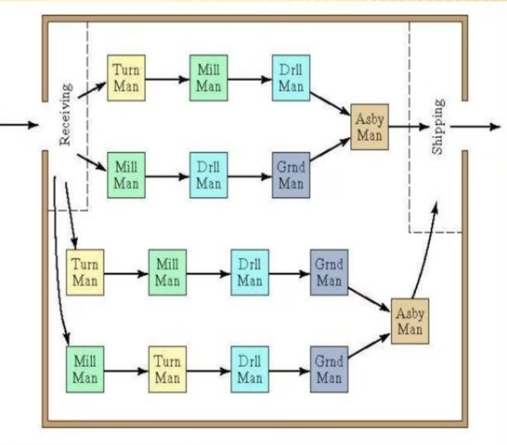
Each cell is specializes in producing one or a limited number of part families
Cellular manufacturing when automated then it is called as flexible manufacturing system(FMS)

Slide 23
Advantages
Faster processing time – less manufacturing time
Less material handling
Improved efficiency of workers
Less WIP inventory
Boredom factor is less for workers
Disadvantages
Require more time for grouping- more initial investment
Require more analysis of data- more supervising is needed

Slide 24
Combined Layout
A combination of process and product layout combines the advantages of both types of layouts
Useful when item is being made in different types and sizes
Machinery arranged in process layout but process grouping is then arranged in sequence to manufacture various types and sizes of products.
It is noted that sequence of operations remains same with variety of products and sizes
E. g. for industries involving the fabrication of parts and assembly, fabrication tends to employ the process layout and assembly areas often employ the product layout

Slide 25
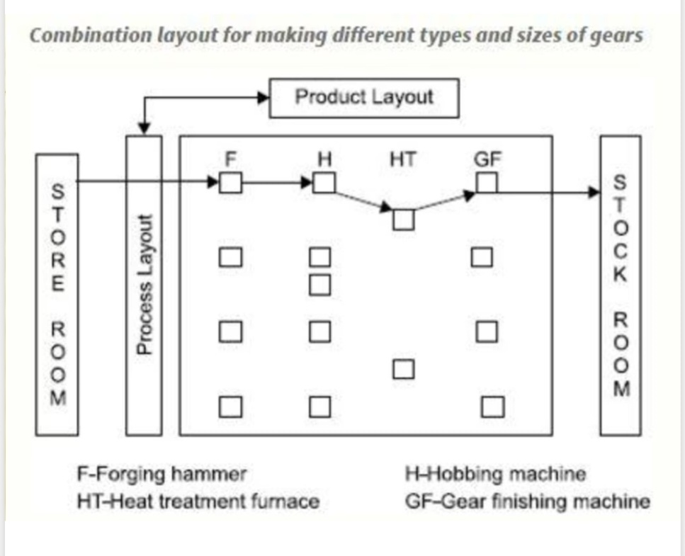
In soap manufacturing plant, the machinery manufacturing soap is arranged on the product line principle , but ancillary services such as heating, the manufacturing of glycerin, the power house, the water treatment plant etc. are arranged on a process layout basis

Slide 26
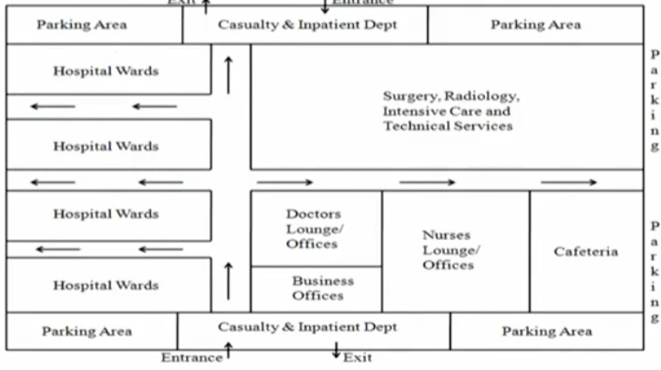
Service Facility Layout
Service oriented industries like banks, hospitals etc.

Slide 27
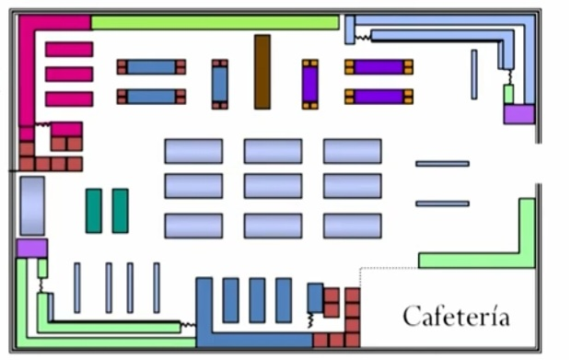
Retail layout patterns
Rectangular with parallel aisles
Formal
Controls traffic flow
Uses selling space efficiently

Slide 28
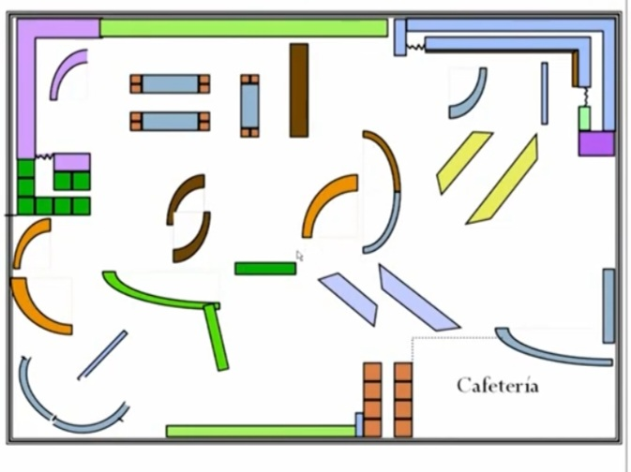
Free Form
Free flowing
Informal
Creates friendly environment
Flexible

Slide 29
Revision of layout
Revision of existing layout
Minor changes to complete dismantling of the existing structure
To increase operating efficiency of the plant
Why Revision?????
Expansion
Technological advancements
Improvement in the layout

Slide 30
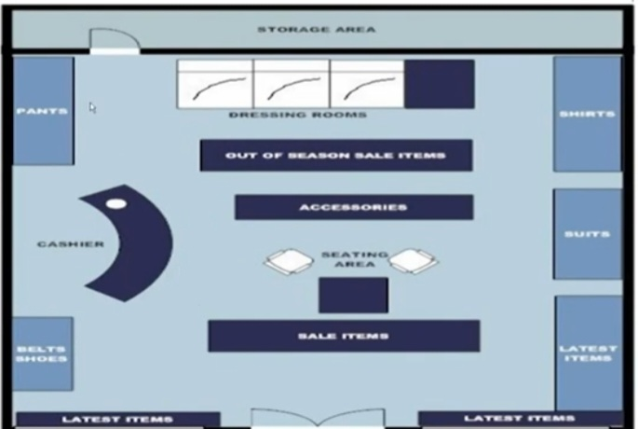
Boutique
Unique shopping environment
Divides store into a series of individual shopping areas
Each with its own theme

Slide 31
Factors Influencing Facility layout planning
Product
Types of product whether it is heavy or light, big or small, liquid or solid in nature
- for uniform type of products, product layout is suitable
- for customized products, process layout is suitable
- for bulky products, fixed position layout is suitable
Sales and demand influence plant layout
Volume and quality are important factors

Slide 32
Materials
Types of raw material- solid, liquid, gas ,heavy, small or large
Need for the storage of different types of material
Movement and placement of different types of materials during processing

Slide 33
Manpower
Availability
Skill and experience
Position of employees- satisfactory or moving
Employee safety

Slide 34
Factory Building
The nature and size of the building determines the floor space available for the layout
While designing the factory building following requirement must be keep in mind
e. g. air conditioning, dust control, humidity control etc.

Slide 35
Location
Topography
Shape and size of plant
Climatic condition
Availability of water, raw material and power
Waste disposal facility

Slide 36
Policies of management
Volume of production
Size of plant
Sales and marketing policies
Purchasing policies
Facilities to employees
Future targets

Slide 37
Nature of manufacturing process
Synthetic process
- Under this process two or more materials are mixed to get a product Example- cement manufacturing
Analytical process
- Under this method different products are extracted from one material. Example- Extraction of oil from crude
Conditional process
- Under this process the original raw material is given the shape of different products and nothing is added to it. Jute is an important example of this kind
Extractive process
- This method involves the extraction of product from the original material by application of heat or pressure

Slide 38
Volume of production
Plant layout is generally determined by taking into consideration the quantum of products to be produced
- Job production
- Batch Production
- Mass Production

Slide 39
Tools and Techniques used for facility layout planning
Operation process chart
Flow process chart
Flow diagram
Scale Models

Slide 40
Operation Process chart
The manufacturing process is divided into separate activities with the help of the operation process chart
It shows
- The points at which materials are introduced into the process
- The sequence of various operations
- Inspections
This charts represents the basic activities required for producing a product

Slide 41
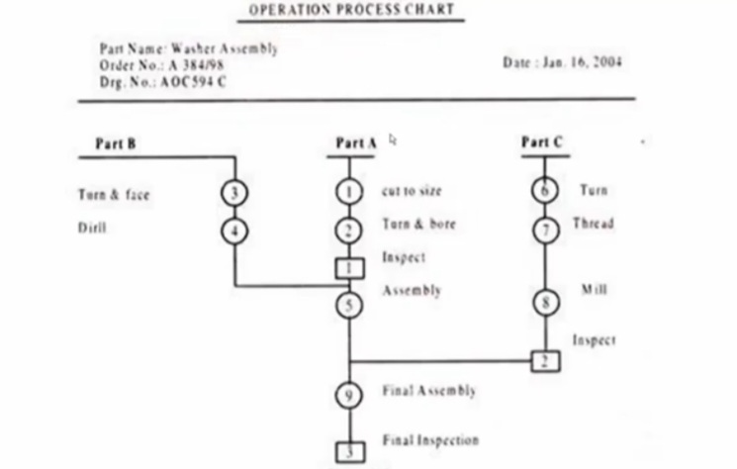

Slide 42
Advantages
To improve plant layout
Helps in the satisfying the basic manufacturing system
Helps in determining sequence of operations
To introduce the new technical personnel with the manufacturing system

Slide 43
Flow Process chart
Graphic representation of all the production activities occurring on the shop floor
Includes operations, transportation, shortage and delay
On the basis of this analysis, operations may be combined, rearranged or eliminated.

Slide 44
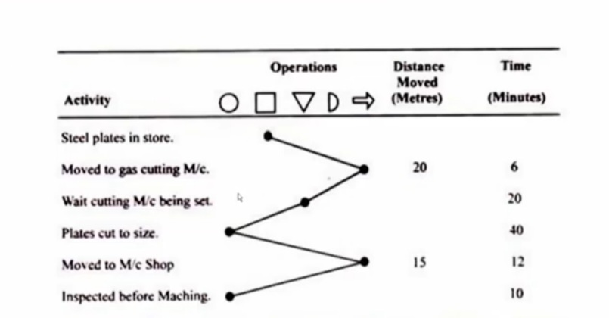

Slide 45
Flow diagrams
This diagram is used to supplement the flow process chart
Represent graphically the relative position of the productive machinery space, gangways etc. and path followed by the man and materials
To study a process for efficiency and improvement. It helps to shows unnecessary steps, bottlenecks and other inefficiencies

Slide 46
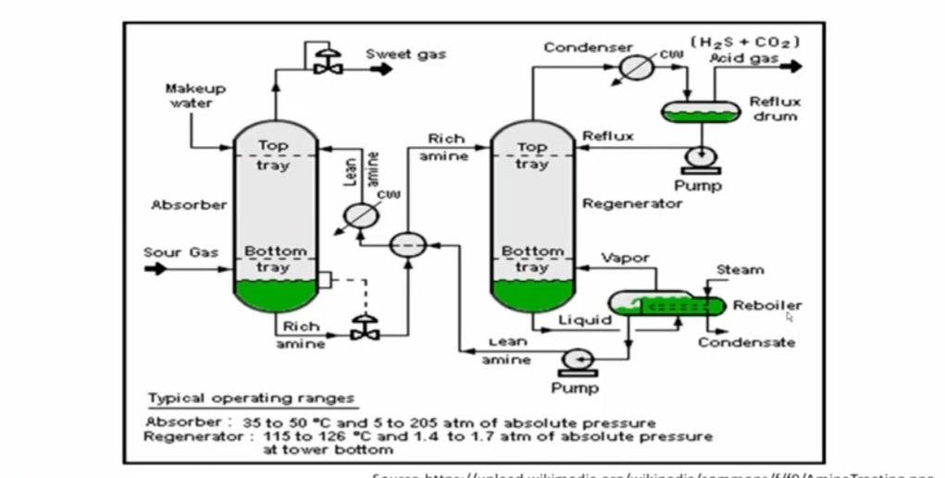

Slide 47
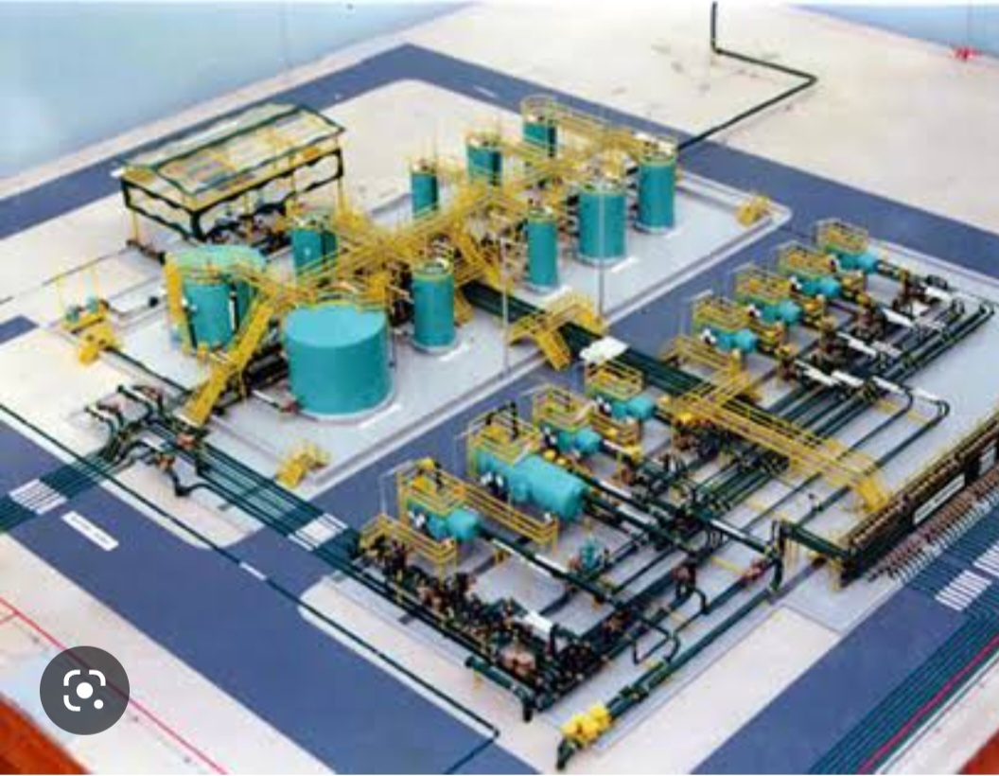
Scale models
Scale model provide a three- dimensional layout
These models may be of wood plastic or metals
Represent real situation and define the plant perfectly and are easy to understand

Slide 48
Recent trends in plant layout
The use of computerized facilities design
The various techniques have been developed and used in layout engineering such as ALDEP( Automated layout design program), CORELAP(Computerized relationship layout planning) , CRAFT( Computerized related allocation of facilities technique), CALP( Computer Aided layout planning) etc. these programme can save time and efforts in large and complex layout problems

Slide 49
Questions for continuous Internal Evaluation
Q.1 What is plant layout? State objectives of good plant layout
Q. 2. Explain principles of good plant layout also explain importance of plant layout
Q. 3 Explain differences between product layout and Process layout
Q.4 Explain the factors influencing plant layout
Q. 5 Explain different tools used for plant layout planning
Q.6. What are the different types of layout explain with their advantages and disadvantages.

Slide 50
Thank You

